Slide 1
CAR Calibration Meeting CAR Review
AP Team
Tony Hsu, Motomu Kawano, Samantha Bang and Erica Qin
September 17, 2014

Slide 2
CAR# 143913016
Summaries:
Observation
Analysis
Containment - Reassign MEL UV testing
Decision on whether traceback is needed
Response Escalation 1,2,3
Implementation Escalation 1,2,3

Slide 3
CAR# 143913016
Correction Requested:
The way this CAR is being handled is very confusing. It is definitely not being treated as an observation. And it is not being treated sufficiently as a finding, e.g., no root cause statement, unclear corrective actions, other items as noted.
Please correct the CAR.
If it is an observation, all actions other than fixing the objective evidence must be done outside of the CAR.
If it is a finding, it must be updated to correctly address all the requirements for finding CARs.

Slide 4
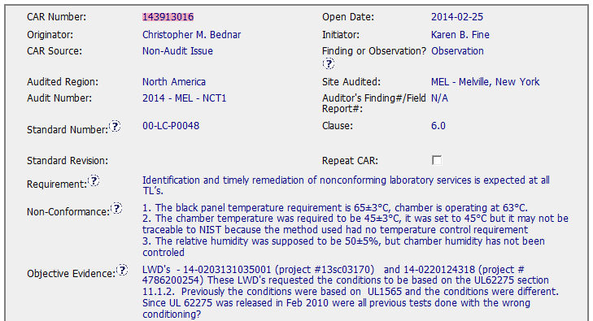
CAR 143913016
Finding or Observation?
Includes all of the required background info?
Is it a Non-Conformance?
Needs for the more clear description
based on the fact
Notes:
<00-QA-S0009 UL Glossary of Terms and Acronyms>
• OBSERVATION – A nonconformance that does not appear to be systemic, recurring or severe. Observations can also be written to document opportunities for improvement.
• FINDING – A nonconformance that is systemic, and/or recurring, and/or severe.
<LWD>
LWD - abbreviation of Lab Work Directive (LWD) in Lotus Notes

Slide 5
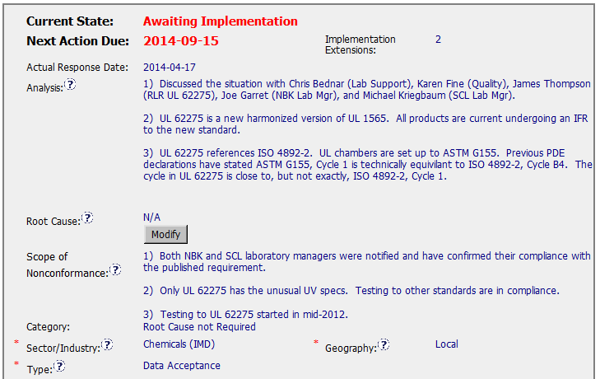
CAR 143913016
Observation, but carried out the analysis
- all pertinent questions addressed?
- clear path to root cause?
- stakeholders identified?
“not applicable” for the observation
(C) Analysis shows clear path to root cause and scope; stakeholders identified – Need Improve
(C) Root cause statement is succinct, reasonable, complete (Shows ‘N/A’ for observations) - Moderate
(T) Most appropriate ‘category’, ‘type’, ‘geography’ are selected - Moderate

Slide 6
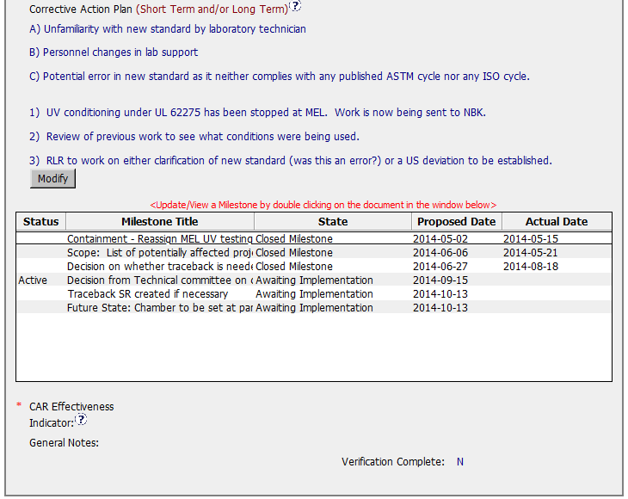
CAR 143913016
– fix the objective evidence? Yes

Slide 7
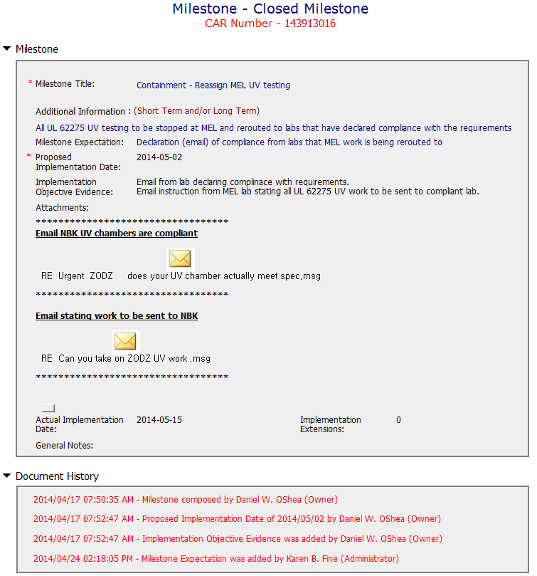
CAR 143913016 – Milestone 1
address containment
completed per milestone expectations
(C) Corrective actions fix the objective evidence and other problems found; address entire root cause and scope. For observations, they do not go beyond fixing the objective evidence - Moderate
(C) Milestones address containment & owner’s verification; completed per milestone expectations - Excellent
(L) Referenced communications are attached as needed - Excellent

Slide 8
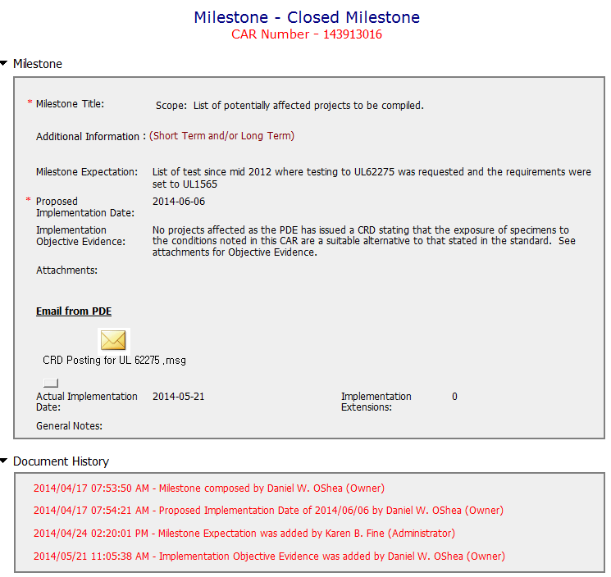
CAR 143913016 – Milestone 2
completed per milestone expectations
(C) Milestones address containment & owner’s verification; completed per milestone expectations - Excellent
(L) Referenced communications are attached as needed - Excellent

Slide 9
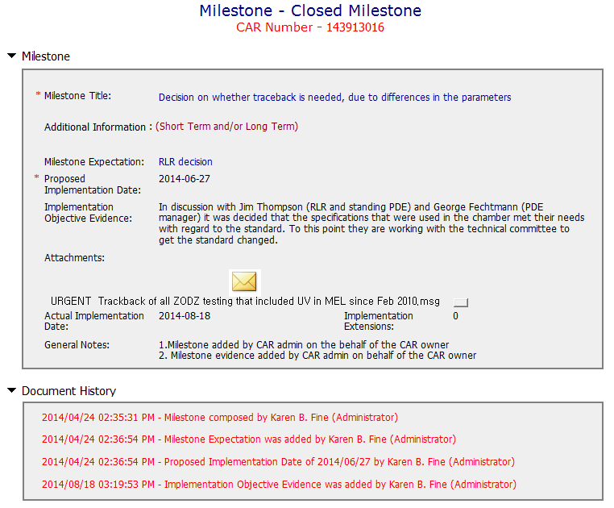
CAR 143913016 – Milestone 3
completed per milestone expectations
(C) Milestones address containment & owner’s verification; completed per milestone expectations - Excellent
(L) Referenced communications are attached as needed - Excellent

Slide 10
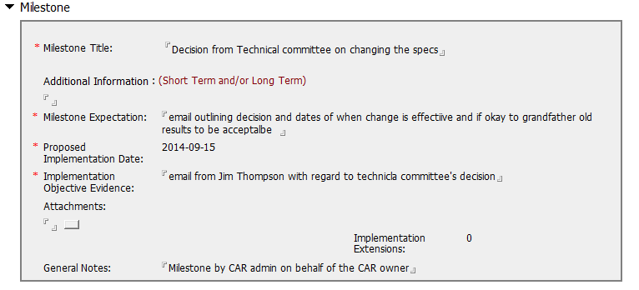
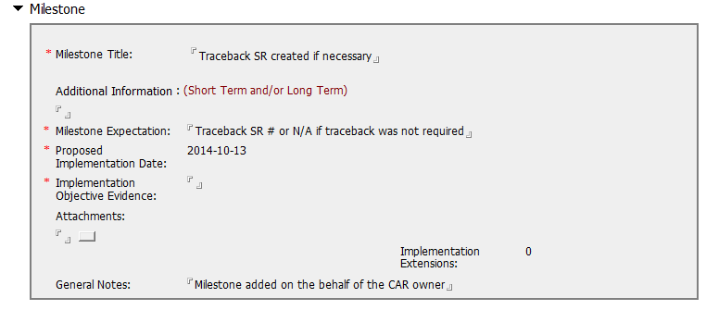
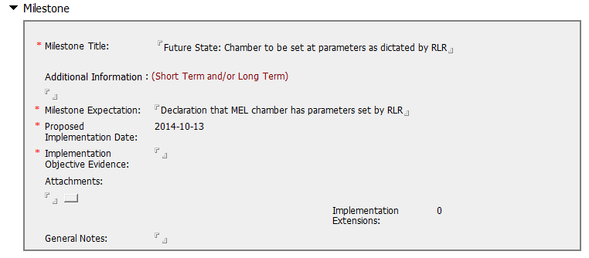
CAR 143913016 – Milestones
Based on the results of the milestones 1,2,3

Slide 11
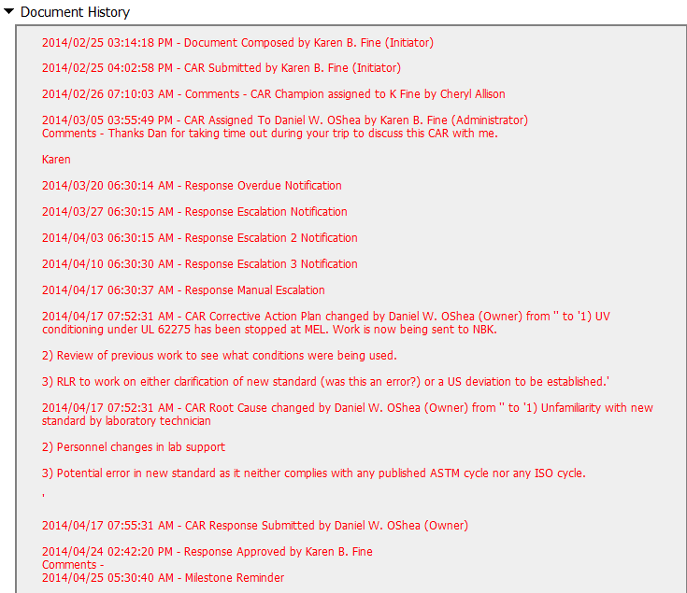
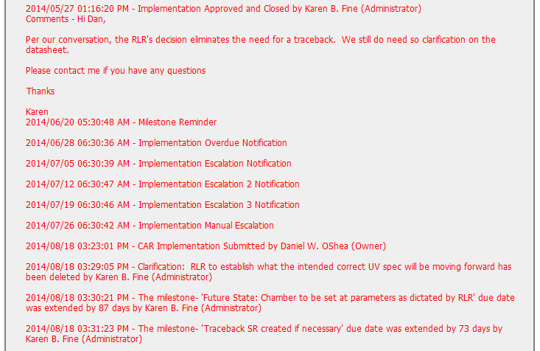
CAR 143913016 – History Study
Response Escalations
Evidence of communication for overdue CAR
Implementation Escalation
(C) Extensions are within requirement (<30 days, 3 or less) – Need Improve
(T) Acts on CARs within required timeframe – Need Improve
(C L) Evidence of communication for overdue/escalated CARs and other pertinent concerns - Moderate

Slide 12
CAR 143913016 – CBS Check
CBS Requirements | Excellent | Moderate | Need Improve | N/A
(C) Extensions are within requirement (<30 days, 3 or less) |  |  | X
(T) Most appropriate ‘category’, ‘type’, ‘geography’ are selected |  | X
(P) Facilitates the handling of disputed CARs |  |  |  | X
(T) Acts on CARs within required timeframe |  |  | X
(C) Analysis shows clear path to root cause and scope; stakeholders identified |  |  | X
(C) Root cause statement is succinct, reasonable, complete (Shows ‘N/A’ for observations) |  | X
(C) Corrective actions fix the objective evidence and other problems found; address entire root cause and scope. For observations, they do not go beyond fixing the objective evidence |  | X
(C) Milestones address containment & owner’s verification; completed per milestone expectations | X
(P) Verification per requirements |  |  |  | X
(L) Referenced communications are attached as needed | X
(C L) Evidence of communication for overdue/escalated CARs and other pertinent concerns |  | X
(P) Trains other CAR Champions |  |  |  | X

